Slide 1
Information Translation
Elevator Pitch
Data Doppelgänger
Lane Snively
Quinton Hetland

Slide 2
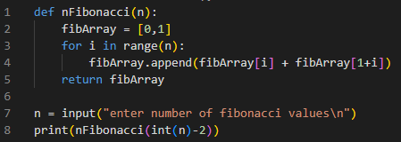
Functional Programming - enormous data stored as function
fib(0) = | 0
fib(1) = | 1
fib(2) = | 1
fib(3) = | 2
fib(4) = | 3
fib(5) = | 5
fib(6) = | 8
fib(7) = | 13
fib(8) = | 21
… | …

Slide 3
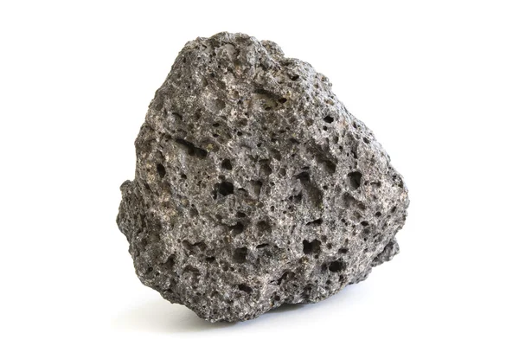
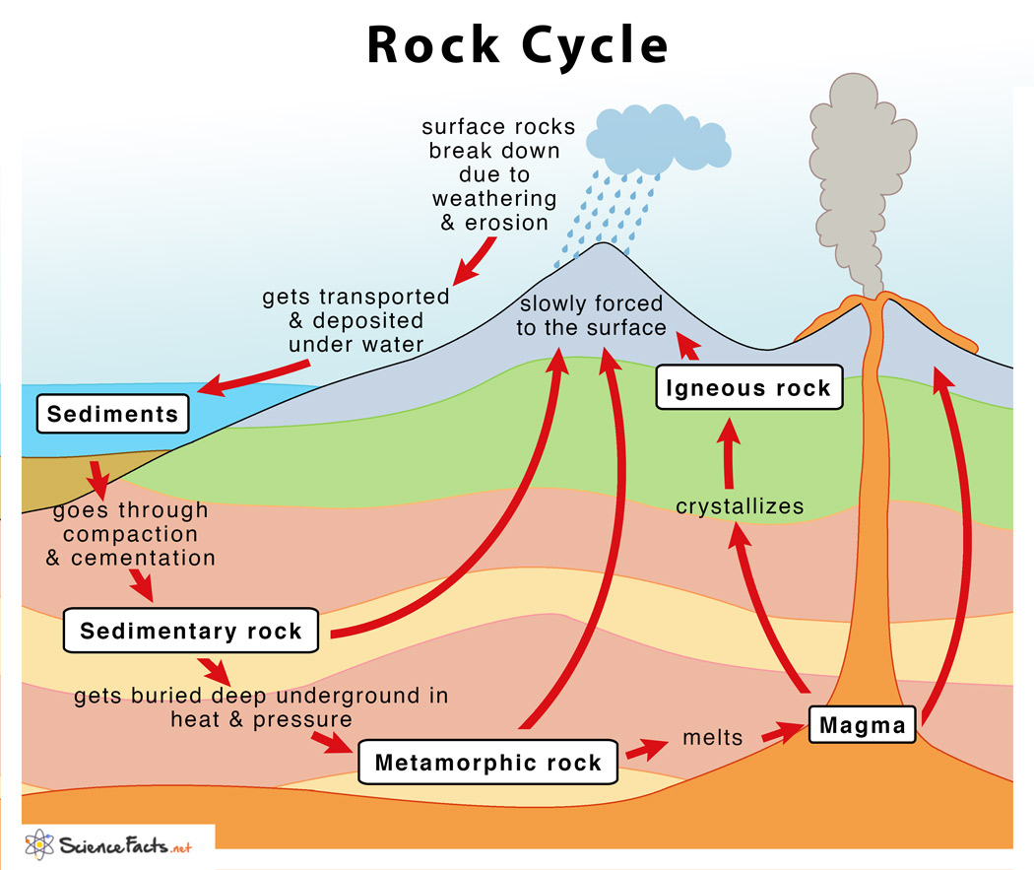


Rock Cycle - dense information represented in small space

Slide 4

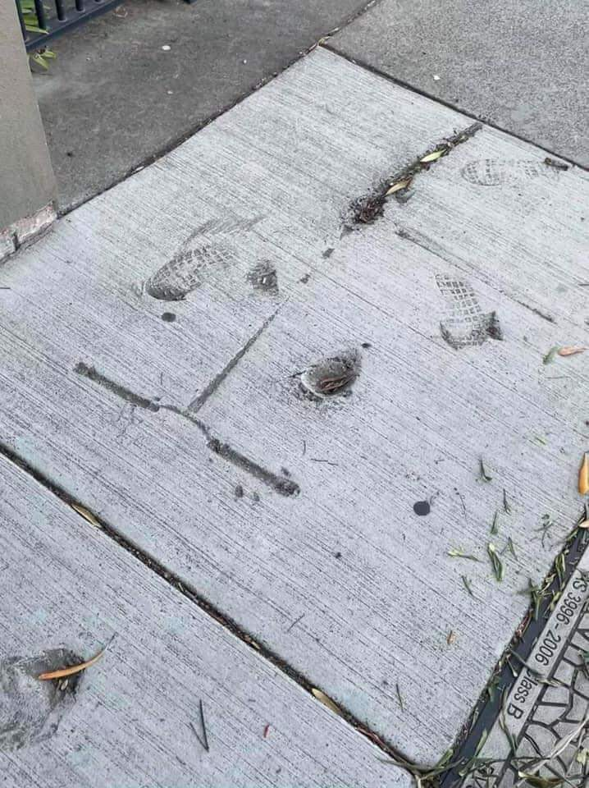

Slide 5

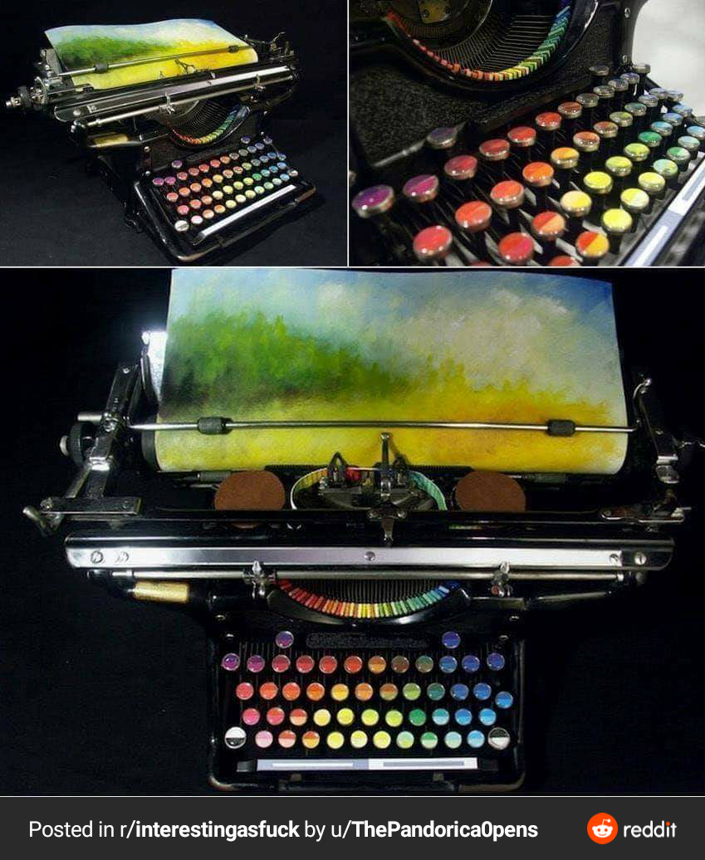
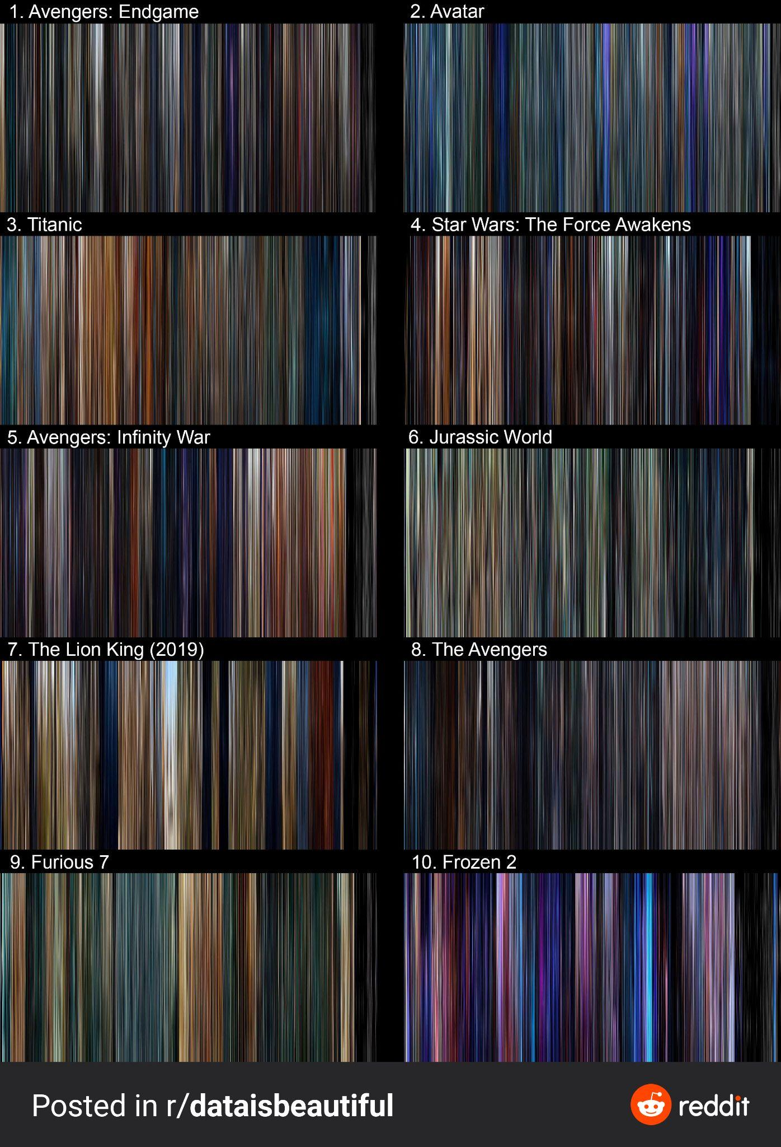
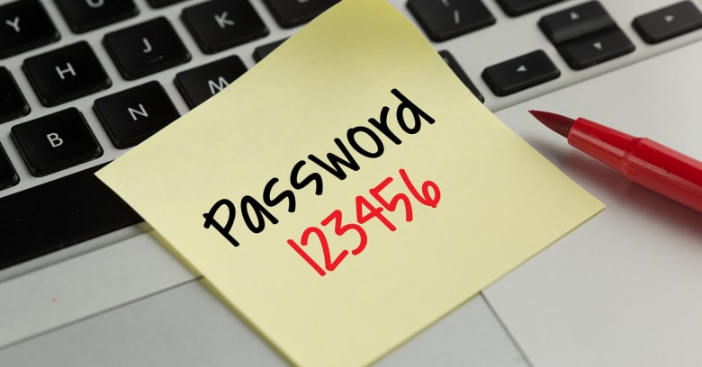
Applications
Image → password
Music / art generation from text
Sentiment analysis

